Slide 1
Unit 3
Teacher: iddo sadeh

Slide 2
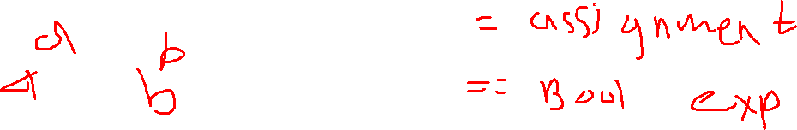
Boolean expressions
== (equals)
!= (not equals)
Return True or False values

Slide 3
Relational Operators
< Less Than
> Greater Than
<= Less than or equal to
>= Greater than or equal to
== Equals
!= Does not equal
*used only for numerical operations. Use String Class methods for string comparasions.

Slide 4
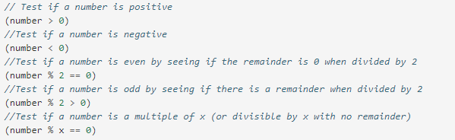
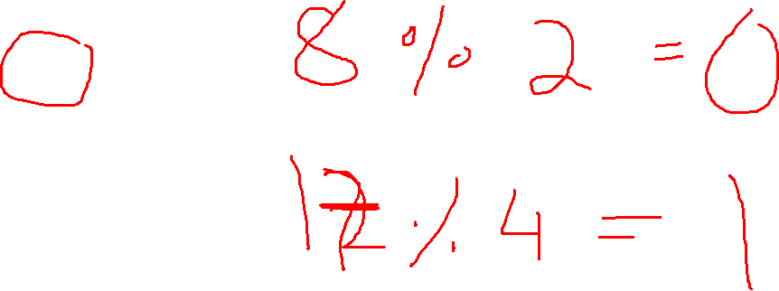
Testing with %
*taken from CSAwesome textbook

Slide 5
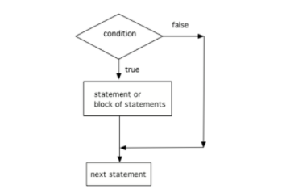

Conditional statements
*taken from CSAwesome textbook

Slide 6
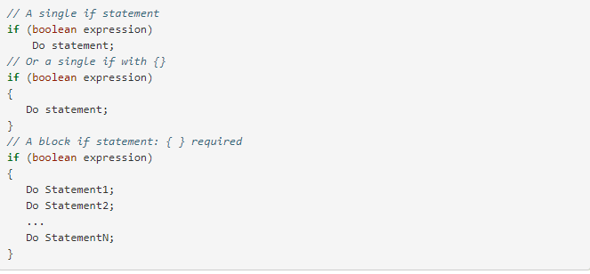
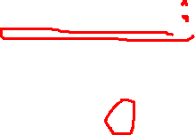
If statements
*taken from CSAwesome textbook

Slide 7

Common errors
Always use curly brackets { and } to enclose the block of statements under the if condition. Java doesn’t care if you indent the code – it goes by the { }.
Don’t put in a semicolon ; after the first line of the if statement, if (test);. The if statement is a multiline block of code that starts with the if condition and then { the body of the if statement }.
Always use ==, not =, in the condition of an if statement to test a variable. One = assigns, two == tests!

Slide 8
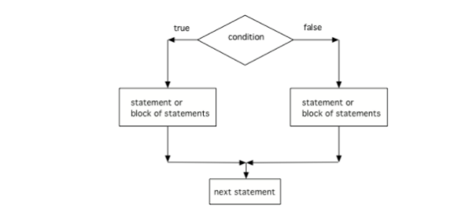
Else statements

Slide 9
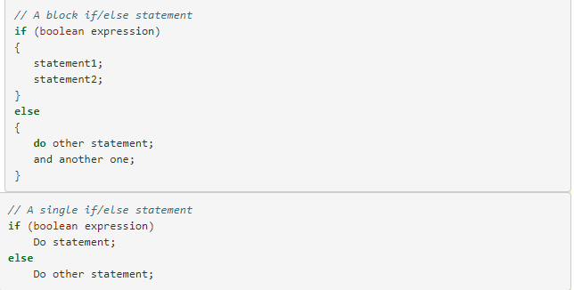


Slide 10
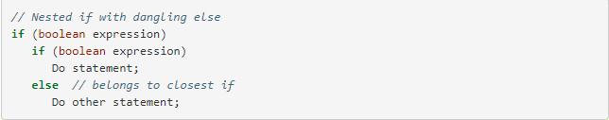

Nested ifs and Dangling Else
Notes:
If statements can be nested inside other if statements. Sometimes with nested ifs we find a dangling else that could potentially belong to either if statement. The rule is that the else clause will always be a part of the closest if statement in the same block of code, regardless of indentation.

Slide 11
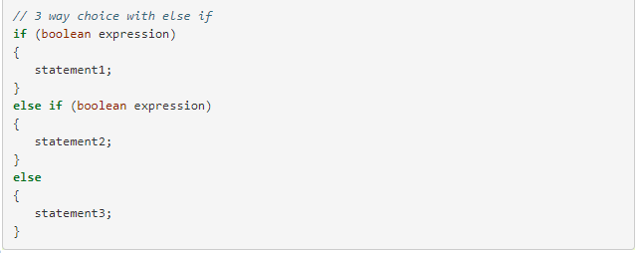

Else-if statements

Slide 12
Compound Boolean expressions
&& - and (if you want two things to be true before the body of the conditional is executed)
|| - or (if it is okay if only one of two things is true)
! – not (can be used to negate a boolean value)
In Java, ! has precedence (is executed before) && which has precedence over ||. Parentheses can be used to force the order of execution in a different way

Slide 13
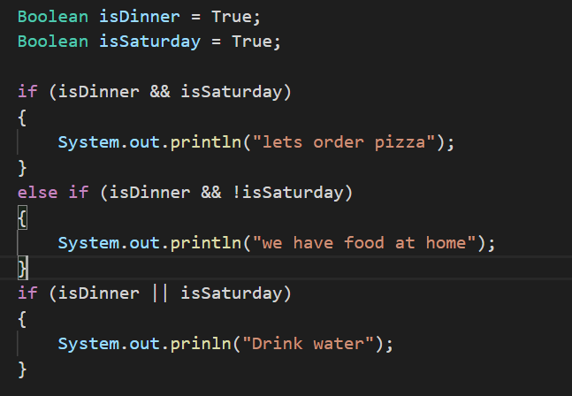
Notes:
example

Slide 14
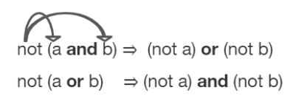
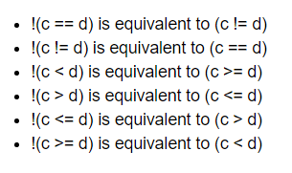
De morgan’s law
Developed by Augustus De Morgan in the 1800s
simplify the negation of a complex boolean expression
Notes:
you do not have to memorize De Morgan’s Laws for the CS A Exam

Slide 15
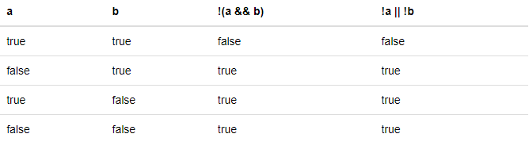
Truth tables
Notes:
you should be able to show that two boolean expressions are equivalent

Slide 16
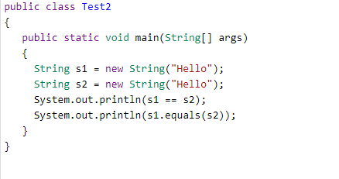
Comparing objects
Notes:
What do you think gets printed?

Slide 17
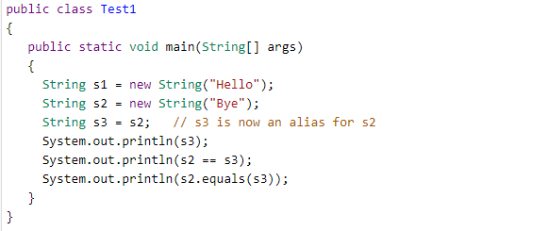

Slide 18
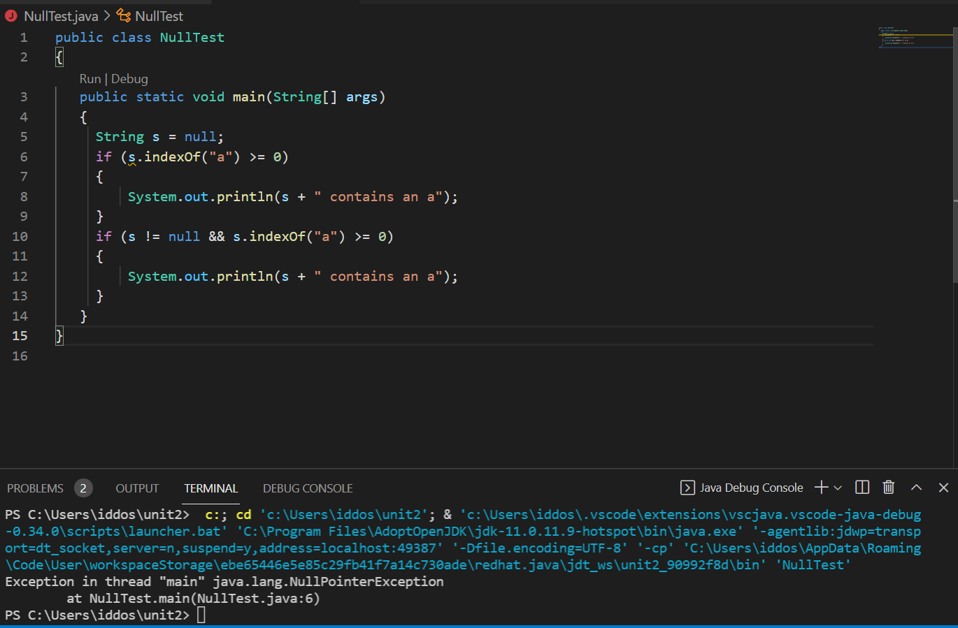
Comparing to NUll
Notes:
Show example

Slide 19
Often classes have their own equals method, which can be used to determine whether two objects of the class are equivalent.
Two object references are considered aliases when they both reference the same object.
Object reference values can be compared, using == and !=, to identify aliases.
A reference value can be compared with null, using == or !=, to determine if the reference actually references an object.

